Slide 1

Rigidity of Configurations of Points and Spheres
Opal Graham
Florida State University
Notes:
Thank the organizers

Slide 2


Beardon & Minda
$$𝕊^{2}$$
Conformal automorphisms of finitely connected regions (’08)
$$𝕊^{2}$$
Notes:
The story of rigidity of points and spheres starts with a paper by Beardon and Minda, and follow-up work by Crane and Short. Finite collection, two dimensions, non-intersecting circles.

Slide 3






$$C_{i}$$
$$C_{j}$$
Beardon & Minda
$$𝕊^{2}$$
$$C_{j}^{′}$$
$$C_{i}^{′}$$
$$𝕊^{2}$$
Conformal automorphisms of finitely connected regions (’08)
Notes:
Finite collection, two dimensions, non-intersecting circles. Note inversive distance is a Mobius invariant of two oriented circles and that it’s not a true distance.

Slide 4

$$C_{i}$$
$$C_{j}$$
Beardon & Minda
$$𝕊^{2}$$
$$∃ f∈ M\ddot{o}b\left(𝕊^{2}\right)$$
$$C_{j}^{′}$$
$$C_{i}^{′}$$
$$𝕊^{2}$$
Conformal automorphisms of finitely connected regions (’08)
Notes:
Finite collection, two dimensions, non-intersecting circles. Note inversive distance is a Mobius invariant of two oriented circles and that it’s not a true distance.

Slide 5
Beardon & Minda
$$𝕊^{2}$$
Conformal automorphisms of finitely connected regions (’08)
$$𝕊^{2}$$
Notes:
Finite collection, absolute inversive distance, two dimensions.

Slide 6

Beardon & Minda
$$𝕊^{2}$$
$\left|p_{i},p_{j},p_{k}, p_{l}\right|=\left|p_{i}^{′},p_{j}^{′},p_{k}^{′}, p_{l}^{′}\right| ∀$ 4-tuples
Conformal automorphisms of finitely connected regions (’08)
$$𝕊^{2}$$
Notes:
Finite collection, absolute inversive distance, two dimensions. What is absolute cross ratio?

Slide 7
Beardon & Minda
$$𝕊^{2}$$
$\left|p_{i},p_{j},p_{k}, p_{l}\right|=\left|p_{i}^{′},p_{j}^{′},p_{k}^{′}, p_{l}^{′}\right| ∀$ 4-tuples
$$∃ f∈ M\ddot{o}b\left(𝕊^{2}\right)$$
Conformal automorphisms of finitely connected regions (’08)
$$𝕊^{2}$$
Notes:
Finite collection, absolute inversive distance, two dimensions. What is absolute cross ratio?

Slide 8

Beardon & Minda
Question 1. Is the conclusion valid when $C_{1},…, C_{m}$ are any set of $m$ distinct circles in $ℂ_{∞}$?
$$𝕊^{2}$$
$$∃ f∈ M\ddot{o}b\left(𝕊^{2}\right)$$
$$𝕊^{2}$$
Conformal automorphisms of finitely connected regions (’08)

Slide 9

Beardon & Minda
Question 1. Is the conclusion valid when $C_{1},…, C_{m}$ are any set of $m$ distinct circles in $ℂ_{∞}$?
Crane & Short Answer: Yes, with appropriate conditions.
$$𝕊^{2}$$
$$∃ f∈ M\ddot{o}b\left(𝕊^{2}\right)$$
$$𝕊^{2}$$
Conformal automorphisms of finitely connected regions (’08)

Slide 10



Beardon & Minda
Question 2. Do both theorems generalize to higher dimensions?
$$𝕊^{n−1}$$
$$∃ f∈ M\ddot{o}b\left(𝕊^{n−1}\right)$$
$$𝕊^{n−1}$$
Conformal automorphisms of finitely connected regions (’08)

Slide 11
Beardon & Minda
Question 2. Do both theorems generalize to higher dimensions?
Crane & Short Answer: Yes
$$𝕊^{n−1}$$
$$∃ f∈ M\ddot{o}b\left(𝕊^{n−1}\right)$$
$$𝕊^{n−1}$$
Conformal automorphisms of finitely connected regions (’08)

Slide 12
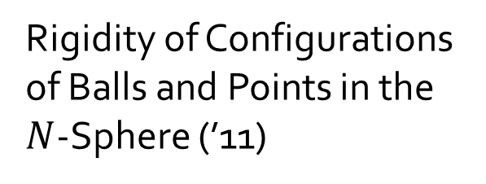
Crane & Short
Question 2. Do both theorems generalize to higher dimensions?
Crane & Short Answer: Yes
$$𝕊^{n−1}$$
$$∃ f∈ M\ddot{o}b\left(𝕊^{n−1}\right)$$
Rigidity of Configurations of Balls and Points in the $N$-Sphere (’11)
$$𝕊^{n−1}$$
Notes:
Need to mention that here, countable collection; not necessarily finite. N-2 dimensional spheres can intersect in any way as long as they don’t all contain same point.

Slide 13
Crane & Short
Requires all inversive distance information.
$$𝕊^{n−1}$$
$$∃ f∈ M\ddot{o}b\left(𝕊^{n−1}\right)$$
Rigidity of Configurations of Balls and Points in the $N$-Sphere (’11)
$$𝕊^{n−1}$$

Slide 14
Crane & Short
Requires all inversive distance information.
New question: Can these results be improved upon?
$$𝕊^{n−1}$$
$$∃ f∈ M\ddot{o}b\left(𝕊^{n−1}\right)$$
Rigidity of Configurations of Balls and Points in the $N$-Sphere (’11)
$$𝕊^{n−1}$$

Slide 15




Lorentz Space
$$ℝ^{n+1}$$
$$y$$
$$ℝ^{n}$$
$$x$$
Notes:
In n+1 space, copy of n-space at every level of t. At t=1 affine copy of n-space where…

Slide 16



Lorentz Space
$$ℝ^{n+1}$$
$$v$$
$ℝ^{n+1}$, $\left\langle ⋅\right\rangle$:
$$\left\langle u,v\right\rangle =u_{1}v_{1}+…+u_{n}v_{n}−u_{n+1}v_{n+1}$$
$$u$$
$$y$$
$$ℝ^{n}$$
$$x$$
Notes:
N+1 space equipped with LIP: Lorentz inner product not a true inner product b/c not positive definite.

Slide 17

Lorentz Space
$$ℝ^{n+1}$$
$$v$$
$$𝕊^{n−1}$$
$ℝ^{n+1}$, $\left\langle ⋅\right\rangle$:
$$\left\langle u,v\right\rangle =u_{1}v_{1}+…+u_{n}v_{n}−u_{n+1}v_{n+1}$$
$$u$$
$$y$$
$$ℝ^{n}$$
$$x$$
Notes:
N-1 sphere resides that serves as ideal boundary for…

Slide 18

Lorentz Space
$$ℝ^{n+1}$$
$$v$$
$$ℍ^{n}$$
$$𝕊^{n−1}$$
$ℝ^{n+1}$, $\left\langle ⋅\right\rangle$:
$$\left\langle u,v\right\rangle =u_{1}v_{1}+…+u_{n}v_{n}−u_{n+1}v_{n+1}$$
$$u$$
$$y$$
$$ℝ^{n}$$
$$x$$
Notes:
Klein model of hyperbolic space. All of these spaces lie within what’s called Lorentz space which is…

Slide 19
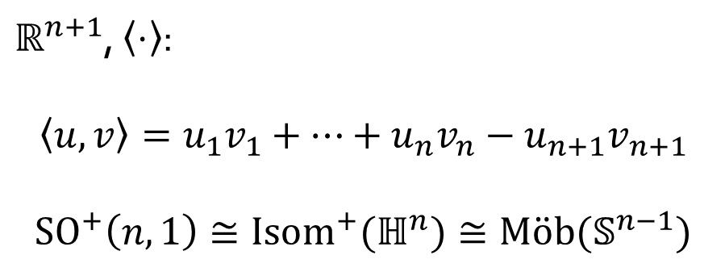
Lorentz Space
$$ℝ^{n+1}$$
$$v$$
$$ℍ^{n}$$
$$𝕊^{n−1}$$
$ℝ^{n+1}$, $\left\langle ⋅\right\rangle$:
$$\left\langle u,v\right\rangle =u_{1}v_{1}+…+u_{n}v_{n}−u_{n+1}v_{n+1}$$
$${SO}^{+}\left(n,1\right)≅{Isom}^{+}(ℍ^{n})≅M\ddot{o}b(𝕊^{n−1})$$
$$u$$
$$y$$
$$ℝ^{n}$$
$$x$$
Notes:
The group of Orientation preserving projective transformations (which preserve LIP) is SO+(n,1) are iso to the orientation preserving isometries of hyperbolic n-space, which are the o.p. mobius transformations acting on the ideal boundary. Tells us that if we want to find a Mobius transformation, we zoom out and find a Lorentz transformation.

Slide 20

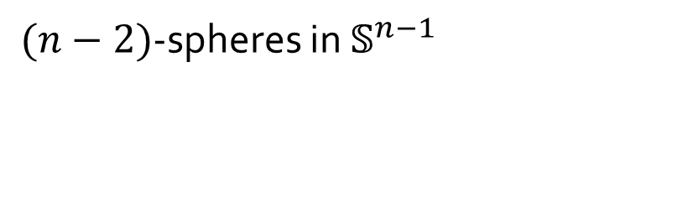
Lorentz Space
$$ℝ^{n+1}$$
$$ℍ^{n}$$
$$𝕊^{n−1}$$
$(n−2)$-spheres in $𝕊^{n−1}$
$$y$$
$$ℝ^{n}$$
$$x$$

Slide 21



Lorentz Space
$$ℝ^{n+1}$$
$$⟷$$
$$ℍ^{n}$$
$$𝕊^{n−1}$$
$(n−2)$-spheres in $𝕊^{n−1}$
Time-like Lorentz subspaces of $ℝ^{n+1}$
$$⟷$$
$$y$$
$$ℝ^{n}$$
$$x$$

Slide 22

Lorentz Space
$$ℝ^{n+1}$$
$$⟷$$
$$ℍ^{n}$$
$$𝕊^{n−1}$$
$(n−2)$-spheres in $𝕊^{n−1}$
Time-like Lorentz subspaces of $ℝ^{n+1}$
Space-like Lorentz vectors
$$⟷$$
$$y$$
$$ℝ^{n}$$
$$x$$

Slide 23
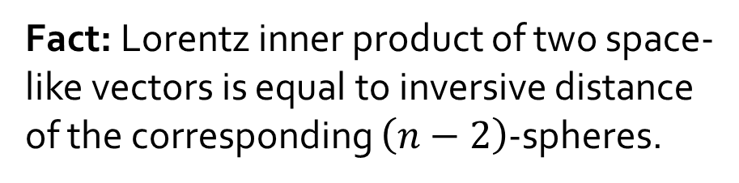
Lorentz Space
$$ℝ^{n+1}$$
$$⟷$$
$$ℍ^{n}$$
$$𝕊^{n−1}$$
$(n−2)$-spheres in $𝕊^{n−1}$
Time-like Lorentz subspaces of $ℝ^{n+1}$
Space-like Lorentz vectors
$$⟷$$
$$y$$
$$ℝ^{n}$$
$$x$$
Fact: Lorentz inner product of two space-like vectors is equal to inversive distance of the corresponding $\left(n−2\right)$-spheres.

Slide 24

Lorentz Space
$$ℝ^{n+1}$$
$$ℍ^{n}$$
$$𝕊^{n−1}$$
Ideal points in $𝕊^{n−1}$
$$y$$
$$ℝ^{n}$$
$$x$$

Slide 25
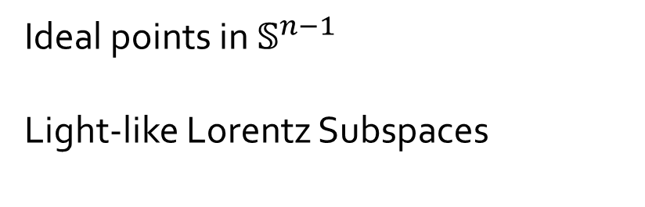

Lorentz Space
$$ℝ^{n+1}$$
$$ℍ^{n}$$
$$𝕊^{n−1}$$
$$⟷$$
Ideal points in $𝕊^{n−1}$
Light-like Lorentz Subspaces
$$y$$
$$ℝ^{n}$$
$$x$$

Slide 26


Lorentz Space
$$ℝ^{n+1}$$
$$ℍ^{n}$$
$$𝕊^{n−1}$$
$$⟷$$
Ideal points in $𝕊^{n−1}$
Light-like Lorentz Subspaces
Light-like Lorentz vectors
$$⟷$$
$$y$$
$$ℝ^{n}$$
$$x$$

Slide 27
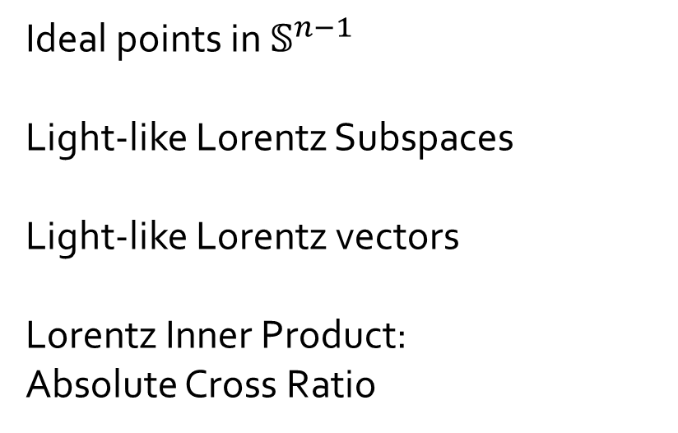
Lorentz Space
$$ℝ^{n+1}$$
$$ℍ^{n}$$
$$𝕊^{n−1}$$
$$⟷$$
Ideal points in $𝕊^{n−1}$
Light-like Lorentz Subspaces
Light-like Lorentz vectors
Lorentz Inner Product:
Absolute Cross Ratio
$$⟷$$
$$y$$
$$ℝ^{n}$$
$$x$$
Notes:
Describe how absolute cross ratio formula involving lip’s of these light-like vectors. Look up the formula. Mention how any vector in this direction is chosen

Slide 28

Linearly Independent Lorentz Vectors
Definition. A collection of $\left(n−2\right)$-spheres in $𝕊^{n−1}⊂ℝ^{n+1}$ is independent if their corresponding Lorentz vectors are linearly independent.
Notes:
Be prepared to say how this corresponds to a notion of independence within geometry of circle space. S6

Slide 29
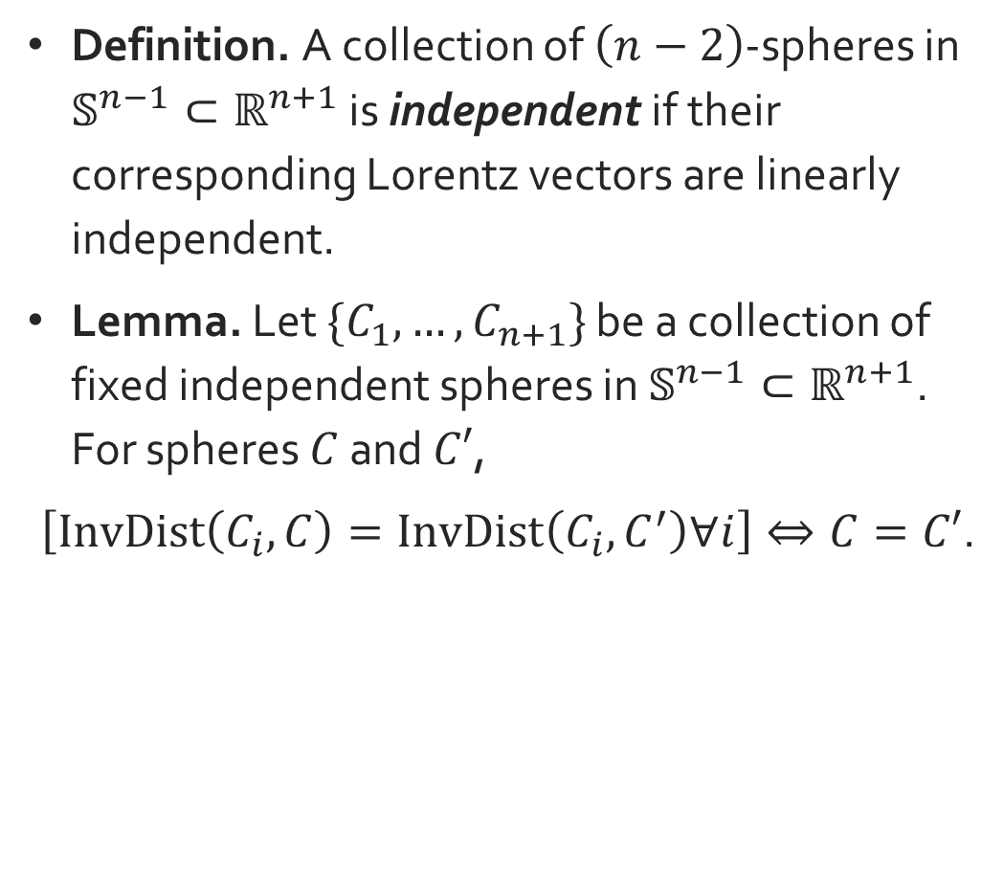
Linearly Independent Lorentz Vectors
Definition. A collection of $\left(n−2\right)$-spheres in $𝕊^{n−1}⊂ℝ^{n+1}$ is independent if their corresponding Lorentz vectors are linearly independent.
Lemma. Let $\{C_{1},…,C_{n+1}\}$ be a collection of fixed independent spheres in $𝕊^{n−1}⊂ℝ^{n+1}$. For spheres $C$ and $C′$,
$\left[InvDist\left(C_{i},C\right)=InvDist\left(C_{i},C^{′}\right)∀i\right]⇔C=C′$.
Notes:
Be prepared to say how this corresponds to a notion of independence within geometry of circle space.

Slide 30
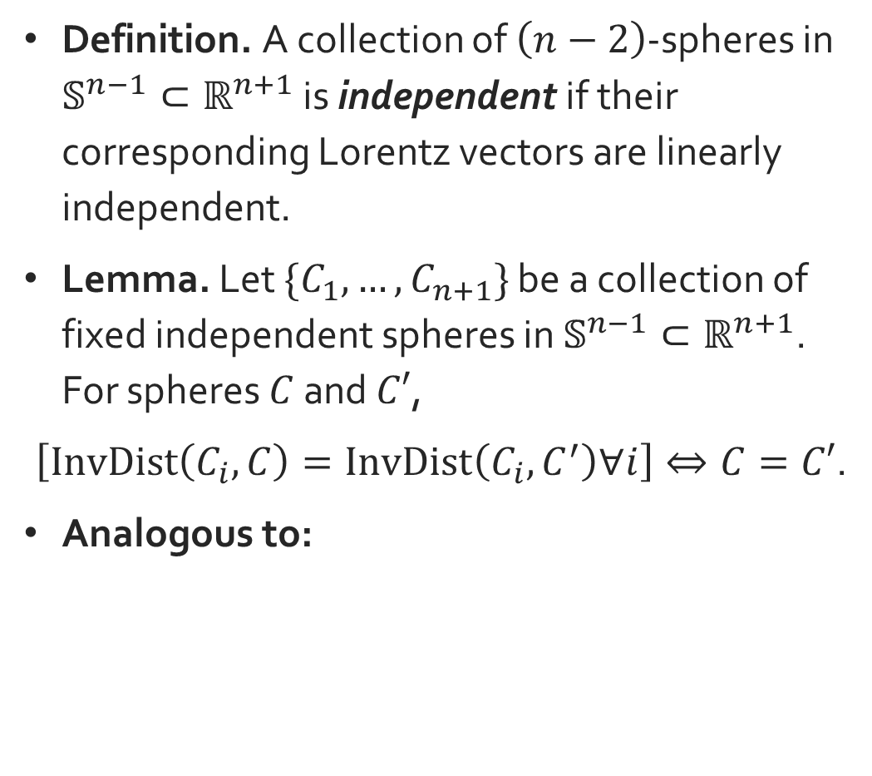

Linearly Independent Lorentz Vectors
Definition. A collection of $\left(n−2\right)$-spheres in $𝕊^{n−1}⊂ℝ^{n+1}$ is independent if their corresponding Lorentz vectors are linearly independent.
Lemma. Let $\{C_{1},…,C_{n+1}\}$ be a collection of fixed independent spheres in $𝕊^{n−1}⊂ℝ^{n+1}$. For spheres $C$ and $C′$,
$\left[InvDist\left(C_{i},C\right)=InvDist\left(C_{i},C^{′}\right)∀i\right]⇔C=C′$.
Analogous to:
$$a$$
Notes:
Be prepared to say how this corresponds to a notion of independence within geometry of circle space. For Euclidean ex: We don’t actually get unique point until we know its distance from 3 points – the minimum # of points for independent collection in 2D plane

Slide 31
Linearly Independent Lorentz Vectors
Definition. A collection of $\left(n−2\right)$-spheres in $𝕊^{n−1}⊂ℝ^{n+1}$ is independent if their corresponding Lorentz vectors are linearly independent.
Lemma. Let $\{C_{1},…,C_{n+1}\}$ be a collection of fixed independent spheres in $𝕊^{n−1}⊂ℝ^{n+1}$. For spheres $C$ and $C′$,
$\left[InvDist\left(C_{i},C\right)=InvDist\left(C_{i},C^{′}\right)∀i\right]⇔C=C′$.
Analogous to:
$$a$$
Notes:
Be prepared to say how this corresponds to a notion of independence within geometry of circle space.

Slide 32


Linearly Independent Lorentz Vectors
Definition. A collection of $\left(n−2\right)$-spheres in $𝕊^{n−1}⊂ℝ^{n+1}$ is independent if their corresponding Lorentz vectors are linearly independent.
Lemma. Let $\{C_{1},…,C_{n+1}\}$ be a collection of fixed independent spheres in $𝕊^{n−1}⊂ℝ^{n+1}$. For spheres $C$ and $C′$,
$\left[InvDist\left(C_{i},C\right)=InvDist\left(C_{i},C^{′}\right)∀i\right]⇔C=C′$.
Analogous to:
$$a$$
$$a$$
$$b$$
Notes:
Be prepared to say how this corresponds to a notion of independence within geometry of circle space.

Slide 33


Linearly Independent Lorentz Vectors
Definition. A collection of $\left(n−2\right)$-spheres in $𝕊^{n−1}⊂ℝ^{n+1}$ is independent if their corresponding Lorentz vectors are linearly independent.
Lemma. Let $\{C_{1},…,C_{n+1}\}$ be a collection of fixed independent spheres in $𝕊^{n−1}⊂ℝ^{n+1}$. For spheres $C$ and $C′$,
$\left[InvDist\left(C_{i},C\right)=InvDist\left(C_{i},C^{′}\right)∀i\right]⇔C=C′$.
Analogous to:
$$a$$
$$a$$
$$a$$
$$b$$
$$b$$
Notes:
Be prepared to say how this corresponds to a notion of independence within geometry of circle space.

Slide 34



Linearly Independent Lorentz Vectors
Definition. A collection of $\left(n−2\right)$-spheres in $𝕊^{n−1}⊂ℝ^{n+1}$ is independent if their corresponding Lorentz vectors are linearly independent.
Lemma. Let $\{C_{1},…,C_{n+1}\}$ be a collection of fixed independent spheres in $𝕊^{n−1}⊂ℝ^{n+1}$. For spheres $C$ and $C′$,
$\left[InvDist\left(C_{i},C\right)=InvDist\left(C_{i},C^{′}\right)∀i\right]⇔C=C′$.
Analogous to:
$$a$$
$$a$$
$$a$$
$$a$$
$$b$$
$$c$$
$$b$$
$$b$$
Notes:
Note that it took three known points in 2D (which is our sphere of dimension n-1=2), but for circles, the requirement would be four known.

Slide 35


New Rigidity Statement
$$ℝ^{n+1}$$
$$ℝ^{n+1}$$
Notes:
S8

Slide 36
New Rigidity Statement
$$ℝ^{n+1}$$
$$ℝ^{n+1}$$

Slide 37
New Rigidity Statement
$$ℝ^{n+1}$$
$$ℝ^{n+1}$$

Slide 38
New Rigidity Statement
$$ℝ^{n+1}$$
$$ℝ^{n+1}$$

Slide 39

New Rigidity Statement
$$ℝ^{n+1}$$
$$∃ f∈{SO}^{+} (n,1)$$
$$ℝ^{n+1}$$
Notes:
Check group

Slide 40
New Rigidity Statement – Spheres
$$𝕊^{n−1}$$
$$𝕊^{n−1}$$
Notes:
Known LIPs correspond to known inversive distances,

Slide 41
New Rigidity Statement – Spheres
$$𝕊^{n−1}$$
$$𝕊^{n−1}$$
Notes:
linear independence of vectors yields independence of circles,

Slide 42
New Rigidity Statement – Spheres
$$𝕊^{n−1}$$
$$∃ f∈ M\ddot{o}b\left(𝕊^{n−1}\right)$$
$$𝕊^{n−1}$$
Notes:
Lorentz transformations are mobius transformations

Slide 43
New Rigidity Statement – Spheres
Requires less inversive distance information
$$𝕊^{n−1}$$
$$∃ f∈ M\ddot{o}b\left(𝕊^{n−1}\right)$$
$$𝕊^{n−1}$$
Notes:
Lorentz transformations are mobius transformations

Slide 44

New Rigidity Statement—Points
Ideal Points: Only need $\left|p_{1},p_{2},p_{3},p_{α}\right|=|p_{1}^{′},p_{2}^{′},p_{3}^{′}, p_{α}^{′}|$ for chosen $p_{1},p_{2},p_{3}$ in independent subcollection.
Notes:
Check ideal points statement. Too many points in n+1 subcollection to be independent on n-1 sphere…

Slide 45

New Rigidity Statement—Points
Ideal Points: Only need $\left|p_{1},p_{2},p_{3},p_{α}\right|=|p_{1}^{′},p_{2}^{′},p_{3}^{′}, p_{α}^{′}|$ for chosen $p_{1},p_{2},p_{3}$ in independent subcollection.
Ideal points and spheres:

Slide 46
New Rigidity Statement—Points
Ideal Points: Only need $\left|p_{1},p_{2},p_{3},p_{α}\right|=|p_{1}^{′},p_{2}^{′},p_{3}^{′}, p_{α}^{′}|$ for chosen $p_{1},p_{2},p_{3}$ in independent subcollection.
Ideal points and spheres:
Notes:
At least one extra condition: ideal points can’t be on spheres.

Slide 47
New Rigidity Statement—Points
Ideal Points: Only need $\left|p_{1},p_{2},p_{3},p_{α}\right|=|p_{1}^{′},p_{2}^{′},p_{3}^{′}, p_{α}^{′}|$ for chosen $p_{1},p_{2},p_{3}$ in independent subcollection.
Ideal points and spheres:
Notes:
Take unique circle orthogonal to sphere going through two ideal points

Slide 48
New Rigidity Statement—Points
Ideal Points: Only need $\left|p_{1},p_{2},p_{3},p_{α}\right|=|p_{1}^{′},p_{2}^{′},p_{3}^{′}, p_{α}^{′}|$ for chosen $p_{1},p_{2},p_{3}$ in independent subcollection.
Ideal points and spheres:
Notes:
Use to create new sphere out of two points that is also orthogonal to circle (there is only one). Messy condition: if then, inversive distance info of new collection of spheres known meeting our conditions of our rigidity statement, then there is a MT taking one collection of spheres to other, and in fact, it takes points in one collection to corresponding points in other collection.

Slide 49
Inversive Distance Circle Packings
Notes:
IDCPs are collections of circles whose inversive distance info given in underlying triangulation. In general, two collections of IDCPs with same underlying inversive distance info are not Mobius equivalent.

Slide 50


Inversive Distance Circle Packings
$$C$$
$$C^{′}$$
Notes:
IDCPs are collections of circles whose inversive distance info given in underlying triangulation. In general, two collections of IDCPs with same underlying inversive distance info are not Mobius equivalent.

Slide 51

Inversive Distance Circle Packings
$$C$$
$$InvDist\left(C,C^{′}\right)$$
$$C^{′}$$
Notes:
IDCPs are collections of circles whose inversive distance info given in underlying triangulation. In general, two collections of IDCPs with same underlying inversive distance info are not Mobius equivalent.

Slide 52
Inversive Distance Circle Packings
Ma-Schlenker C-Octahedra in the 2-Sphere
(Bowers & Bowers 2018)
Notes:
Counterxample by Bowers & Bowers: Two collections of circles on S2, one blue with yellow circles, other blue with purple circles. Both have same underlying triangulation of ID info, but there is not a MT taking one CP to the other b/c three circles have been fixed (and MT fixing three circles the identity?)

Slide 53
Inversive Distance Circle Packings
Ma-Schlenker C-Octahedra in the 2-Sphere
(Bowers & Bowers 2018)
Notes:
We see how much extra ID info is needed between circles before rigidity gained, by using independence.

Slide 54
Inversive Distance Circle Packings
Ma-Schlenker C-Octahedra in the 2-Sphere
(Bowers & Bowers 2018)
Notes:
Signifies addition of knowing ID between diagonal circles. Once that extra piece of info is known between the two collections…

Slide 55
Inversive Distance Circle Packings
Ma-Schlenker C-Octahedra in the 2-Sphere
(Bowers & Bowers 2018)
Notes:
We know there’s a MT f taking two four circles to the other four circles b/c four independent circles with corresponding ID info are rigid.

Slide 56
Inversive Distance Circle Packings
Ma-Schlenker C-Octahedra in the 2-Sphere
(Bowers & Bowers 2018)
Notes:
We can do the same thing with these four independent circles (we know independent b/c?) here, where three circles in common with the last grouping of ind circles. There’s a separate MT g taking these four to their corresponding four in other collection. But because they share three of the same circles in common, it can be shown that they must be the same MT

Slide 57
Inversive Distance Circle Packings
Ma-Schlenker C-Octahedra in the 2-Sphere
(Bowers & Bowers 2018)
Notes:
Play this game with the last circle, and we get there’s a MT taking all circles in collection to other collection. We used three extra pieces of ID info, but…

Slide 58
Inversive Distance Circle Packings
Ma-Schlenker C-Octahedra in the 2-Sphere
(Bowers & Bowers 2018)
Notes:
We also never used three pieces of ID info from the packing. Goal is to somehow trade in extra ID info for old info by introducing some extra tools that I won’t get into here.

Slide 59
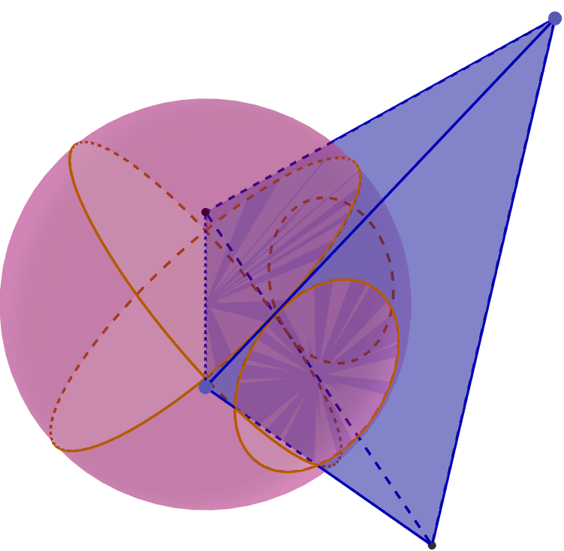
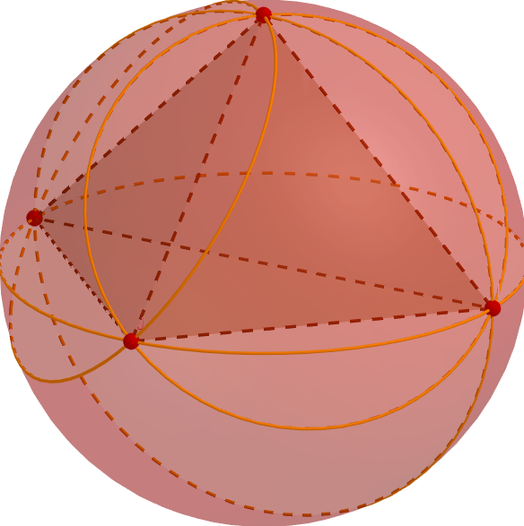
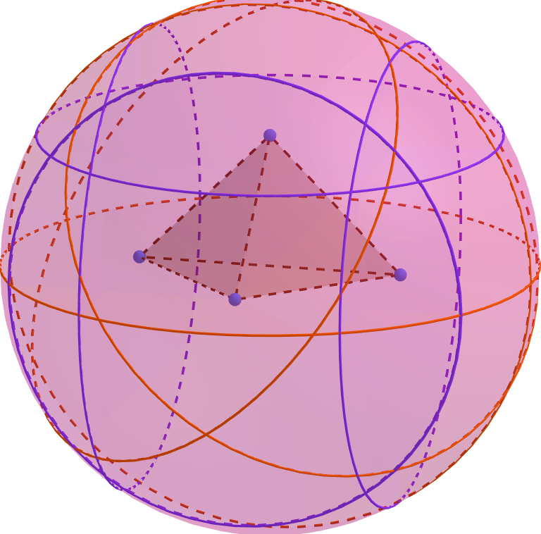
Projective Polyhedra
Notes:
The method described in previous slide is to eventually be applied to what are called circle polyhedra – circle configurations that are created from correspondence shared with projective polyhedra. Gaining conditions for c-polyhedra’s rigidity would give conditions for rigidity of projective polyhedra wrt orientation preserving projective transfs. Note: pictures are showing examples of particular instances where rigidity already known. First is hyperbolic polyhedra, done by Alexandrov(?) then Rivin more broadly (?). Second ideal polyhedra done by Rivin (?), third hyperideal polyhedra, tackled by Bao & Bonahon in one case, and Bowers, Bowers, Pratt in another case. Problem is there is no unifying theorem right now that handles all cases, especially not case where projective polyhedra doesn’t intersect sphere at all. Using independence and a notion of convexity for circle-polyhedra, I hope to tackle this problem.

Slide 60
Projective Polyhedra
Andre’ev (‘70);
Rivin & Hodgson (‘93)
Notes:
The method described in previous slide is to eventually be applied to what are called circle polyhedra – circle configurations that are created from correspondence shared with projective polyhedra. Gaining conditions for c-polyhedra’s rigidity would give conditions for rigidity of projective polyhedra wrt orientation preserving projective transfs. Note: pictures are showing examples of particular instances where rigidity already known. First is hyperbolic polyhedra, done by Alexandrov(?) then Rivin more broadly (?). Second ideal polyhedra done by Rivin (?), third hyperideal polyhedra, tackled by Bao & Bonahon in one case, and Bowers, Bowers, Pratt in another case. Problem is there is no unifying theorem right now that handles all cases, especially not case where projective polyhedra doesn’t intersect sphere at all. Using independence and a notion of convexity for circle-polyhedra, I hope to tackle this problem.

Slide 61
Projective Polyhedra
Rivin (‘96)
Andre’ev (‘70);
Rivin & Hodgson (‘93)
Notes:
The method described in previous slide is to eventually be applied to what are called circle polyhedra – circle configurations that are created from correspondence shared with projective polyhedra. Gaining conditions for c-polyhedra’s rigidity would give conditions for rigidity of projective polyhedra wrt orientation preserving projective transfs. Note: pictures are showing examples of particular instances where rigidity already known. First is hyperbolic polyhedra, done by Alexandrov(?) then Rivin more broadly (?). Second ideal polyhedra done by Rivin (?), third hyperideal polyhedra, tackled by Bao & Bonahon in one case, and Bowers, Bowers, Pratt in another case. Problem is there is no unifying theorem right now that handles all cases, especially not case where projective polyhedra doesn’t intersect sphere at all. Using independence and a notion of convexity for circle-polyhedra, I hope to tackle this problem.

Slide 62
Projective Polyhedra
Rivin (‘96)
Andre’ev (‘70);
Rivin & Hodgson (‘93)
Bao & Bonahon (‘02);
Bowers, Bowers, Pratt (’18)
Notes:
The method described in previous slide is to eventually be applied to what are called circle polyhedra – circle configurations that are created from correspondence shared with projective polyhedra. Gaining conditions for c-polyhedra’s rigidity would give conditions for rigidity of projective polyhedra wrt orientation preserving projective transfs. Note: pictures are showing examples of particular instances where rigidity already known. First is hyperbolic polyhedra, done by Alexandrov(?) then Rivin more broadly (?). Second ideal polyhedra done by Rivin (?), third hyperideal polyhedra, tackled by Bao & Bonahon in one case, and Bowers, Bowers, Pratt in another case. Problem is there is no unifying theorem right now that handles all cases, especially not case where projective polyhedra doesn’t intersect sphere at all. Using independence and a notion of convexity for circle-polyhedra, I hope to tackle this problem.

Slide 63
Thank You!

Slide 64

Lorentz Space
$$ℝ^{n+1}$$
Hyperbolic Points in $ℍ^{n}$
$$ℍ^{n}$$
$$𝕊^{n−1}$$
$$y$$
$$ℝ^{n}$$
$$x$$

Slide 65


Lorentz Space
$$ℝ^{n+1}$$
$$⟷$$
$$ℍ^{n}$$
$$𝕊^{n−1}$$
Hyperbolic Points in $ℍ^{n}$
Space-like Lorentz subspaces
$$y$$
$$ℝ^{n}$$
$$x$$

Slide 66

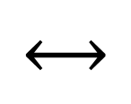
Lorentz Space
$$ℝ^{n+1}$$
$$⟷$$
$$ℍ^{n}$$
$$𝕊^{n−1}$$
Hyperbolic Points in $ℍ^{n}$
Space-like Lorentz subspaces
Time-Like Lorentz unit vectors
$$⟷$$
$$y$$
$$ℝ^{n}$$
$$x$$

Slide 67

Lorentz Space
$$ℝ^{n+1}$$
$$⟷$$
$$ℍ^{n}$$
$$𝕊^{n−1}$$
Hyperbolic Points in $ℍ^{n}$
Space-like Lorentz subspaces
Time-Like Lorentz unit vectors
Fact: Lorentz inner product corresponds to hyperbolic distance
$$⟷$$
$$y$$
$$ℝ^{n}$$
$$x$$
Notes:
Look up cosh graph

Slide 68

New Rigidity Statement—Points
Ideal Points: Only need $\left|p_{1},p_{2},p_{3},p_{α}\right|=|p_{1}^{′},p_{2}^{′},p_{3}^{′}, p_{α}^{′}|$ for chosen $p_{1},p_{2},p_{3}$ in independent subcollection.
Ideal points and spheres:
Hyperbolic points and hyperplanes: Independence?
Notes:
This case presents issues because independence is harder to figure out

Slide 69

New Rigidity Statement—Points
Ideal Points: Only need $\left|p_{1},p_{2},p_{3},p_{α}\right|=|p_{1}^{′},p_{2}^{′},p_{3}^{′}, p_{α}^{′}|$ for chosen $p_{1},p_{2},p_{3}$ in independent subcollection.
Ideal points and spheres:
Hyperbolic points and hyperplanes: Independence?
Notes:
Have two vectors that aren’t linear combinations of each other but..

Slide 70
New Rigidity Statement—Points
Ideal Points: Only need $\left|p_{1},p_{2},p_{3},p_{α}\right|=|p_{1}^{′},p_{2}^{′},p_{3}^{′}, p_{α}^{′}|$ for chosen $p_{1},p_{2},p_{3}$ in independent subcollection.
Ideal points and spheres:
Hyperbolic points and hyperplanes: Independence?
Notes:
Their corresponding hyperbolic objects are not linearly independent. Possibly need an extra condition that says this can’t happen. Other than that, again, LIP corresponds to hyperbolic distance, and LTs are hyperbolic isometries.

Slide 71
Inversive Distance Primer
6 CASES
Notes:
Need to figure out how sign changes for hyperbolic distance between lunes. S3

Slide 72
Inversive Distance Primer
6 CASES
Notes:
Need to figure out how sign changes for hyperbolic distance between lunes. S3

Slide 73
Inversive Distance Primer
6 CASES
Notes:
Need to figure out how sign changes for hyperbolic distance between lunes. S3

Slide 74

Inversive Distance Primer
6 CASES
$$θ$$
Notes:
Need to figure out how sign changes for hyperbolic distance between lunes. S3

Slide 75

Inversive Distance Primer
6 CASES
$$θ$$
$$0≤\left(C,C^{′}\right)=cos\left(θ\right)<1$$
Notes:
Need to figure out how sign changes for hyperbolic distance between lunes. S3

Slide 76
Inversive Distance Primer
6 CASES
$$θ$$
$$0≤\left(C,C^{′}\right)=cos\left(θ\right)<1$$
Notes:
Need to figure out how sign changes for hyperbolic distance between lunes. S3

Slide 77

Inversive Distance Primer
6 CASES
$$θ$$
$$θ$$
$$0≤\left(C,C^{′}\right)=cos\left(θ\right)<1$$
Notes:
Need to figure out how sign changes for hyperbolic distance between lunes. S3

Slide 78

Inversive Distance Primer
6 CASES
$$θ$$
$$θ$$
$$0≤\left(C,C^{′}\right)=cos\left(θ\right)<1$$
$$−1<\left(C,C^{′}\right)=cos\left(θ\right)≤0$$
Notes:
Need to figure out how sign changes for hyperbolic distance between lunes. S3

Slide 79

Inversive Distance Primer
6 CASES
$$θ$$
$$θ$$
$$0≤\left(C,C^{′}\right)=cos\left(θ\right)<1$$
$$−1<\left(C,C^{′}\right)=cos\left(θ\right)≤0$$
$$θ=π$$
Notes:
Need to figure out how sign changes for hyperbolic distance between lunes. S3

Slide 80

Inversive Distance Primer
6 CASES
$$θ$$
$$θ$$
$$0≤\left(C,C^{′}\right)=cos\left(θ\right)<1$$
$$−1<\left(C,C^{′}\right)=cos\left(θ\right)≤0$$
$$θ=π$$
$$\left(C,C^{′}\right)=1$$
Notes:
Need to figure out how sign changes for hyperbolic distance between lunes. S3

Slide 81


Inversive Distance Primer
6 CASES
$$θ$$
$$θ$$
$$0≤\left(C,C^{′}\right)=cos\left(θ\right)<1$$
$$−1<\left(C,C^{′}\right)=cos\left(θ\right)≤0$$
$$θ=π$$
$$θ=0$$
$$\left(C,C^{′}\right)=1$$
$$\left(C,C^{′}\right)=−1$$
Notes:
Need to figure out how sign changes for hyperbolic distance between lunes. S3

Slide 82

Inversive Distance Primer
6 CASES
$$θ$$
$$θ$$
$$0≤\left(C,C^{′}\right)=cos\left(θ\right)<1$$
$$−1<\left(C,C^{′}\right)=cos\left(θ\right)≤0$$
$$θ=π$$
$$θ=0$$
$$\left(C,C^{′}\right)=1$$
$$\left(C,C^{′}\right)=−1$$
$$d_{H}(x,y)$$
Notes:
Need to figure out how sign changes for hyperbolic distance between lunes. S3

Slide 83

Inversive Distance Primer
6 CASES
$$θ$$
$$θ$$
$$0≤\left(C,C^{′}\right)=cos\left(θ\right)<1$$
$$−1<\left(C,C^{′}\right)=cos\left(θ\right)≤0$$
$$θ=π$$
$$θ=0$$
$$\left(C,C^{′}\right)=1$$
$$\left(C,C^{′}\right)=−1$$
$$d_{H}(x,y)$$
$$1<\left(C,C^{′}\right)=cos\left(id_{H}(x,y)\right)<∞$$
Notes:
Need to figure out how sign changes for hyperbolic distance between lunes. S3

Slide 84


Inversive Distance Primer
6 CASES
$$θ$$
$$θ$$
$$0≤\left(C,C^{′}\right)=cos\left(θ\right)<1$$
$$−1<\left(C,C^{′}\right)=cos\left(θ\right)≤0$$
$$θ=π$$
$$θ=0$$
$$\left(C,C^{′}\right)=1$$
$$\left(C,C^{′}\right)=−1$$
$$d_{H}(x,y)$$
$$d_{H}(x,y)$$
$$1<\left(C,C^{′}\right)=cos\left(id_{H}(x,y)\right)<∞$$
$$−∞<\left(C,C^{′}\right)<−1$$
Notes:
Need to figure out how sign changes for hyperbolic distance between lunes. S3

Slide 85




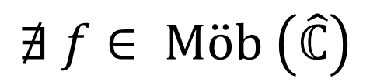




Crane & Short’s Condition
$$C_{1}$$
$$C_{2}$$
$$C_{1}^{′}$$
$$C_{2}^{′}$$
$$C_{3}$$
$$C_{3}^{′}$$
$$C_{4}$$
$$C_{4}^{′}$$
$$∄ f∈ M\ddot{o}b \left(\hat{ℂ}\right)$$
Notes:
S4

Slide 86








Crane & Short’s Condition
$$C_{1}$$
$$C_{2}$$
$$C_{1}^{′}$$
$$C_{2}^{′}$$
$$C_{3}$$
$$C_{3}^{′}$$
$$C_{4}$$
$$C_{4}^{′}$$
Notes:
S7

Slide 87

Crane & Short’s Condition
$$C_{1}$$
$$C_{2}$$
$$C_{1}^{′}$$
$$C_{2}^{′}$$
$$C_{3}$$
$$C_{3}^{′}$$
$$C_{4}$$
$$C_{4}^{′}$$
Point $∞$ common to all circles

Slide 88

Crane & Short’s Condition
$$C_{1}$$
$$C_{2}$$
$$C_{1}^{′}$$
$$C_{2}^{′}$$
$$C_{3}$$
$$C_{3}^{′}$$
$$C_{4}$$
$$C_{4}^{′}$$
Point $∞$ common to all circles
All space-like vectors lie on common light-like space
$$⟷$$
Notes:
Independence is a stronger condition than requiring they can’t all have one point in common.

